Slide 1

Introduction to E-Commerce
Prepared by
Risala Tasin Khan
Professor
IIT, JU

Slide 2
What is E-Commerce
Electronic commerce, abbreviated as E-Commerce, is doing business activities over an electronic medium such as the Internet.
In other words, Sharing Business Information, Maintaining Business relationships and Conducting business transactions using computers connected to a Telecommunication Network is called E-Commerce.
The fundamental purpose of e-commerce is to execute business transactions which include orders sent to vendors to supply items, invoices sent by vendors, payments made by credit cards, cash or e-cash.

Slide 3
Definition of E-Commerce on Various Perspective
From a buyer’s perspective:
From a buyer’s perspective, e-commerce is the process of buying or acquiring goods or services through-
Realizing the need
Researching a product
Selecting a vendor
Providing payment
Accepting delivery
Using product support

Slide 4
From a seller’s perspective (Continue..)
From a seller’s perspective, e-commerce means sellers business practices by-
Market research to identify customer needs.
Manufacturing products or supplying services that meet customer needs.
Marketing and advertising to make customers aware of available products and services.
Providing a method for acquiring payments.
Making arrangements for delivery of the product.
Providing after-sales support.

Slide 5
Early generation of Internet
Mid-1990s, the prediction of using Internet in Business World was not even in consideration.
Web sites were viewed as optional extras that looked impressive, but didn’t actually do very much.
E-mails were treated with suspicion and considered by many as either an impersonal or an impractical way of communicating.
Cheaper Internet access, ever faster and more powerful connections and the rise of the “mobile Internet” have all played their part in the online revolution.
The main factor, though, is the “INTERNET” itself: a vast network of information and resources that allows people to interact with each other from anywhere in the world.

Slide 6
Reasons behind the success of E-Commerce
There are four main reasons for people going on the Internet:
To find information;
To be entertained;
To interact;
To shop;
If a Web site cannot satisfy any of the above criteria, it is unlikely to become a cyber success.
Therefore, any e-commerce site should be designed from the perspective of end-user.
This “outside in” approach is the key to every effective site, from Amazon to Yahoo!

Slide 7
Difference between E-Commerce and Traditional Commerce
Different Practice:
Online shopping is completely different practice to shopping on the high street.
People who arrive at your site are there because they have sought you out, not because you have an attractive workplace or because you are conveniently located.
Businesses are now expected to inform and interact with their customers at a closer level than ever before.
The old business cry of “location, location, location” has now been over-shadowed by the voice of e-business: “information, information, information”.
Another difference is that you have lot more competition.

Slide 8
Five Web watch words
Speed:
The Internet is said to move at seven times the speed of normal time.
It is expected that e-mail messages are responded to on the same day, Web sites are continually being updated and online markets evolve within a matter of weeks.
Intimacy:
Although the Internet is often viewed as cold and inhuman, it actually allows businesses to get closer to their customers than ever before.
As Kevin Roberts, CEO of Saatchi & Saatchi Worldwide, says, “people open up and share how they feel on the Net---something they just don’t do in more classical research formats such as focus groups.”

Slide 9
Five Web watch words(cont…)
Communication:
The Internet aids communication both between a business and its customers and within the business.
The convenience of e-mail and the accessibility of Web sites mean that employers and customers are less likely to be kept in the dark.
Information:
The Web is the world’s largest and most up-to-date research library.
You can find out more information about more information about your competitors, your customers and your industry than even before.
At the same time, people will also be able to find out more about you.

Slide 10
Five Web watch words(cont…)
Interactivity:
Unlike traditional media, the Internet is highly interactive.
One of the consequences of this is that people pull information towards them.
This means that on the Net more effort is sometimes needed to differentiate your business from its competition.
The Net’s interactivity makes it possible for users to tailor more information according to their own particular requirements.
It therefore allows a business to communicate on a one-to-one level with all its customers simultaneously.
Instead of broadcasting your message to the world, the Net enables you to narrowcast and communicate with individual on their own terms.

Slide 11
Net Benefits
Saving Money:
The Internet can help your business save on the administration costs of taking orders by automating the process.
E-mail can help you save on stationary costs and online marketing often proves a lot more cost-effective than marketing offline
Improving Customer Service:
By increasing the possibilities for communication between your business and its customers, you can often offer an improved level of service to your existing customers.
Keeping Records of Your Activity:
Because the Internet enables you to store information, you can keep track of all business correspondence very easily.

Slide 12
Net Benefits(Cont…)
Attracting New Staff:
The World Wide Web is now one of the most important resources for searching anything new.
Preserving Your Market Share:
The Internet is not only a means of expanding your business, it is also a way to protect and hold on to the market you have already established.
Real world businesses risk losing out to slick start-ups if they don’t embrace the Internet with open arms.

Slide 13
Net Benefits(Cont…)
Making Money:
The Internet offers businesses new ways of making additional revenue by affiliate programs, selling advertising space, securing sponsorship and various other methods.
Going worldwide:
Your Web site can help you reach a worldwide market as geographical limitations are all but eliminated.
Being in a Constant Contact:
The Internet transforms your 9 to 5 business into a 24-hour operation. Your Web site works while you are asleep.
Knowing your Market:
As the Internet is interactive, you can receive constant feedback from your audience

Slide 14
Types of E-Commerce
There are FOUR main modes of e-commerce:
Business-to-Business E-Commerce (B2B)
Business-to-Consumer E-Commerce (B2C)
Customer-to-Consumer E-Commerce (C2C)
Consumer-to-Business E-Commerce (C2B)
Another new entrant is Government to Customer (G2C) and Government to Business (G2B) in which individuals and business organizations can transact business with the government using the Internet

Slide 15
Business-to-Business E-Commerce (B2B)
Business-to-business (B2B) describes commerce transactions between business companies, such as between a manufacturer and a distributor, or between a wholesaler and a retailer. Businesses focus on selling to other businesses.
Business to business e-commerce (B2B e-commerce) is perhaps the most important of the three e-commerce modes.
It is growing very fast and it is predicted that most businesses in the world will participate in B2B e-commerce during this decade.
We will illustrate B2B e-commerce with an example of a business purchasing goods electronically from a vendor.

Slide 16
How B2B transaction works
The two parties are the purchaser and the vendor. Business organizations normally have their own local area network which connects all computers of their organization.
A purchase transaction initiated by a purchaser proceeds as follows:
1. purchase order is entered by the purchaser's office using a computer and transmitted by e-mail to the vendor.
A standard format for purchase orders (sent by e-mail) is called Electronic Data Interchange. (EDI) standard may be used or a mutually agreed format may be used.
There is also a need to sign the purchase order electronically to meet legal requirements.

Slide 17
B2B(Cont…)
2. When the purchase order is received, the vendor immediately acknowledges it electronically.
Observe that the purchase order need not be entered manually again by the vendor's clerk.
This is in contrast to current computerized systems in which a vendor's clerk has to enter manually the purchase order on a PC (when it is received) for further processing.
Manual entry is slow, prone to errors and expensive as a clerk's time has to be allocated for this.
The inventory database is now searched for the availability of ordered items and appropriate action is taken to (electronically) acknowledge the purchase order.

Slide 18
Cont..
The inventory database of the vendor is updated and a delivery note is prepared to be sent to the receiving office of the purchaser.
Concurrently an invoice for items supplied is transmitted by e-mail to the purchaser's accounts office.
The vendor dispatches the items physically along with a hard copy of delivery note. The delivery note is needed for physical inspection of items received and reconciling them with electronic delivery note and invoice to facilitate payment.

Slide 19
Cont…
3. The items received from the vendor are sent to an inspection office of the purchaser along with the delivery note.
The inspection office physically checks the items for both quantity and quality and sends a discrepancy note of items rejected to the purchase office.
4. The accepted items are sent to the store along with an electronic intimation.
The stores office takes items into stock and also updates the inventory database.
4. Simultaneously the purchase office is intimated to enable it to handle rejected items and to authorize accounts departments to pay for the accepted items

Slide 20
Cont…
5. The accounts office electronically pays for items accepted and taken into stock.
Electronic payment is made by the accounts office by informing its banker to debit authorized amount from its account and credit it to the vendor's bank account.
The vendor's account may be in a different bank. The electronic transfer of funds from one bank account to another bank account is an important aspect of e-commerce.
This is called Electronic Funds Transfer (EFT) and is already used in India for dividend payments, interest payment, etc. Observe that if EFT is used, no hard copy of cheques are sent by mail and the funds transfer is fast.

Slide 21
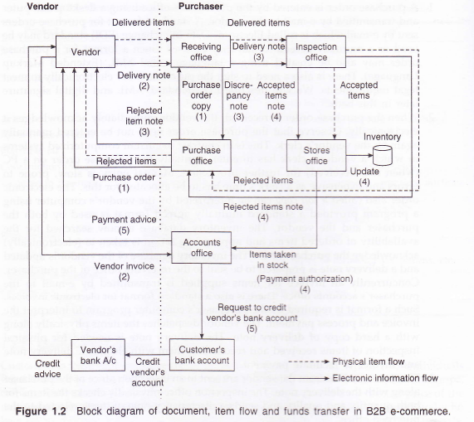

Slide 22
Business to Consumer E-Commerce (B2C)
When an individual buys items from a shop using the Internet and the entire transaction is carried out electronically, we call it business to customer e-commerce and it is abbreviated as B2C e-commerce.
The shops which transact business using the Internet are called by various names, some of which are e-shop, virtual store, dot com shop and cyber shop.
One of the earliest e-shops was a bookstore called amazon.com set up in USA which primarily sells books and has now added other items such as gifts, music CDs, etc.

Slide 23
How B2C model works
Persons who want to shop have to use the Internet. They may have Internet access from home or workplace or an Internet kiosk (i.e., public Internet access point such as cyber cafes).
A customer normally knows the web address of the shop with whom he or she wants to transact business and typically uses a web browser such as Firefox or Internet Explorer and enters the web address of the shop.
The home page of the shop is displayed which provides various options to a customer.
If a customer wants to buy a book, he or she keys in its particulars.
He or she may also request books available on a particular subject in which case the shop would search its database and give a list of books available on that subject.
The shop may also display the contents page of a book selected by the customer, reviews of the book, its cost and discount if any.

Slide 24
Cont…
3. If the customer wants to buy one or more books, he or she points to the book details displayed on the screen using the mouse and clicks.
The vendor's computer enters the prices of the book(s) selected by the customer, provides discount (if any) and displays the net amount payable.
The customer enters the shipping address and payment is usually by credit card. The credit card number is entered which is used for charging the customer.
Sometimes option is_ also given to pay cash on delivery. Credit card payments are more common, As the Internet is not very secure, it is necessary to hide the details of the credit card number. from snoopers and also from the merchant.
The credit card details should be available only to the bank authorizing payment. It is done by using a protocol called Secure Electronic Transaction protocol (abbreviated as SET protocol)

Slide 25
Cont…
4. The credit card details entered by a customer is sent in an encrypted (i.e., secret coded) form over the Internet and is forwarded to the authorizing bank by the merchant.
5. If the credit is OK, the bank authorizes the transaction.
6. The e-shop acknowledges the order and gives the details of delivery- period and mode of shipment as desired by the customer.
7. The e-shop may not stock the items in its warehouse. It sends an electronic request to the distributor to ship the items either directly to the customer or to the e-shop for packing and forwarding.
8. If it is a fast moving item, e-shop will normally stock the item and dispatch it to the customer.
9. The credit card company's bank credits the shop's bank account electronically and sends a bill to the customer.

Slide 26
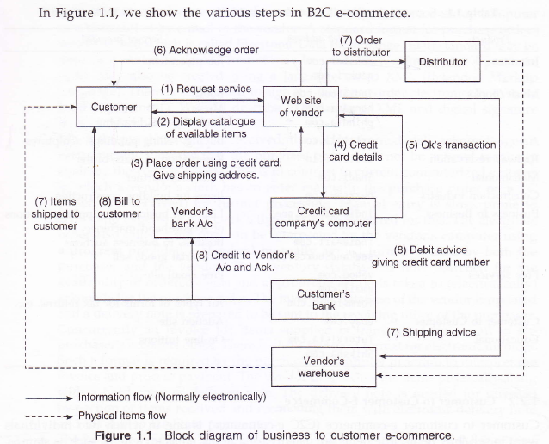

Slide 27
Customer to Customer E-Commerce
Customer to customer e-commerce (C2C e-commerce) is one in which two individuals want to sell/buy items. The items are usually used items, collector's items such as stamps; coins or antiques.
The seller posts the description of the item and the expected price of the item on a web site maintained by a company which acts as a broker
An individual who logs on to this site looking for items may be interested in the item advertised for sale.
He/she then offers to buy the item and may quote a price.
The price is mutually settled between the two parties by exchanging messages through e-mail.

Slide 28
The broker then-arranges to collect the item from the seller and dispatches it to the buyer and collects payment for the item and a fee from the buyer and the seller for services.
The primary advantage of this transaction is that the Internet enables two individuals located at distant places to come together to buy and sell using an intermediary's web address.

Slide 29
Customer to Customer E-Commerce
Customer1
Customer2
Internet
Wants to sell Item 1
Wants to buy Item 1
Broker’s website
•Advertises - "for sale"
•Brings together buyer and seller
•Transports items
•Collects fee from both Seller &Buyer

Slide 30
ADVANTAGES AND DISADVANTAGES OF E-COMMERCE
There are, many advantages of B2C and C2C e-commerce which are enumerated below:
One can buy/sell items from anywhere in the world using one's computer and Internet connection. Transactions can go on 24 hours a day, 7 days a week as the servers maintained by businesses to cater to e-commerce are usually never switched off.
Besides goods, services such as financial, legal and medical consultation may also be obtained using the World Wide Web infrastructure.

Slide 31
The major advantages which accrue to businesses that participate in e-commerce are as follows:
Businesses can reach out to customers worldwide at low cost. A well-designed web page will be an asset to any business to publicize their goods and services and also to sell their merchandise.
Order processing time and cost are reduced as manual entry of data is reduced. When a vendor receives a purchase order, he or she need not re-enter it on his system for data processing. Businesses are also carried out faster as electronic exchange of documents is instantaneous across the world.
A manufacturing organization requires components which are supplied by several vendors.

Slide 32
Electronic funds transfer is fast and safe.
A large number of potential business partners can be quickly found and contacted by searching the World Wide Web.
Certain types of goods can be customized and sold directly by a manufacturer or assembler eliminating middlemen. For example, Dell Computers sells PCs directly to customers configuring them as per individual's requirements. Middlemen such as distributors and retailers are eliminated.
Supply chain management is improved as manufacturers can adjust their inventory level of items and order processing based on customer orders in hand and, customer preferences gathered over a period of time.

Slide 33
The cost of setting up an e-commerce site is quite small compared to the cost of having large premises.
The cost of transactions is quite low. It is estimated that, transaction costs are less than a fifth of that of traditional business.
There are some items such as airline tickets where competing airlines provide several special packages and prices. Quick comparison is possible on the World Wide Web and a confirmed booking obtained on-line.
Companies can maintain on-line e-catalogue of items and a price list which can be quickly updated.

Slide 34
Disadvantage of E-Commerce
Payment by credit card requires faith in the system security. Customers are wary of giving their credit card numbers to vendors who have only a "web presence". Secure credit card transactions in which credit card numbers are encrypted and sent to a vendor are essential.
Electronic Data Interchange standards have to be in place before business to business e-commerce can increase. Small businesses may find it difficult to conform. Data interchange using XML (a new document description language) is expected to solve this problem.

Slide 35
Many persons go shopping for social contacts, touch and feel and bargaining before buying items. E-commerce will de-personalize transactions.
A major concern is security of transactions on the Internet. Spies or hackers can steal and misuse credit card numbers, purchase orders, invoices, etc., if appropriate care is not taken.
Shopping portals will be vulnerable to attacks by hackers unless special precautions are taken. One type of nuisance is called denial of service in which a large number of frivolous enquiries are posted to a portal making it inaccessible to legitimate customers.
Portals have to be protected by special security systems from virus attacks and other electronic vandalism and espionage.

Slide 36
Customers privacy may be lost if regular log is kept of their buying habits.
The web site of vendors should have the capability of being scaled up quickly when the number of users suddenly increases. If the server's capability is limited, the response time of the site will be unacceptably high if a large number of customers decide to use the site. Thus, a vendor should be able to add more servers quickly when this happens.
If there is a sudden increase in orders, there may be logistical problems in physically delivering items to customers. Long delays in receiving ordered goods will adversely affect future sales. Being prepared to handle seasonal surge in demand requires pre-planning.

Slide 37
When a successful e-business is launched, immediately there will be many copy cats who will attempt to duplicate it. Duplication is much simpler in e-commerce compared to traditional business as it is easy to quickly build a web site and start a competitive business. Thus, to maintain the advantage of being first with the idea requires continuous innovation and improvement.
On-line businesses expose their catalogues and price lists to competitors. The advantage of secrecy of traditional mode of doing business is lost.
Not every item is suitable for sale in the web. For example saris, fancy furniture, etc., which require touch and feel are unsuitable for sale through the web.
In spite of these disadvantages, e-commerce is bound to rapidly increase due to its convenience, cost saving and wide reach.

Slide 38
SUPPLY CHAIN MANAGEMENT IN E-COMMERCE
A good supply chain management ensures having the right product, at the right time, at the right place and at the right price.
The primary aim is to reduce the volume of unsold items and ensure that items are not out-of-stock when required.
Most organizations participating in e-commerce would like to have guaranteed delivery of items when required.
There are two strategies that can be followed.

Slide 39
Cont…
If it is a commonly available commodity, then one can follow an e-auction path.
In this strategy a request for e-quotation is publicized in the web on the organization's web site or on an intermediary site specializing in B2B auctions.
Based on the quotes the best option can be picked. This can be done periodically. Based on sales forecasts, delivery schedules can be arranged to ensure just-in-time availability.
This will minimize the cost of procurement and minimize inventory holding cost.

Slide 40
Cont…
2. If the item is specialized where it is important to develop vendors, a cooperative strategy can be followed.
In this case, the cooperating vendor can be allowed access to the demand forecasts and the actual stock position in the database via the extranet or VPN.
Using this information the cooperating vendor can plan the production schedule to meet the expected demand.
When the stock position of the purchaser goes down, the vendor knowing the position can automatically prepare to deliver the items and inform the purchaser electronically.
Such a system ensures for the purchaser and vendor a well­ coordinated seller-buyer relationship and both parties gain.

Slide 41
Characteristics of E-Commerce
Geographic location, abundance of capital or the ownership of the retail outlets is irrelevant to this type of transaction.
Anyone can freely participate in economic activities through e-commerce over a wide range of sectors. That is, anytime, anywhere, anyone can do e-commerce.
E-commerce allows products to be marketed worldwide, while providing a wide array of options to the consumers.
E-commerce must be scalable and adaptable.
It requires security properties such as secrecy, privacy, reliability, and no repudiation. These are the challenges of e-commerce.
Trust and confidence must be established if it is to reach its full potential. E-commerce can survive only if all involved parties can trust the system.
8. E-commerce should be guided by laws.

Slide 42
Three Factors that make E-Commerce Attractive
(1) Choice:
Customers in general enjoy having choices before they decide whether to buy or what price they are willing to pay for a product.
(2) Vast selection:
Online products can be displayed, reviewed, and compared at no cost in time or funds. This feature makes online shopping much more efficient than having to visit after store.
(3) Quick comparison:
Consumers can quick compare products in terms of price, quality, shipping terms and so on before making a final choice.

Slide 43
Business Models for E-Commerce
Business model is a way of doing business to sustain it for generating revenue.
It is a set of planned activities designed to result in a profit in a marketplace.
Key Ingredients of a Business Model:
Value proposition: Why should the customer buy from you?
Revenue model: How will you earn money?
Market opportunity: What market space do you intend to serve?
Competitive environment: Who else occupies you intended market space?
Competitive advantage: What special advantages does your firm bring to the market space?

Slide 44
Key Ingredient of Business Model
Market strategy: How do you plan to promote your products or services?
Organizational development: What types of organizational structures are necessary to carry out the business plan?
Management team: What kinds of experiences and background are important for the managers to have?

Slide 45
Some Business/Revenue Models
There are different business models in e-commerce.
Each model has its own unique features and offerings.
An online business can adopt one business model or more than one models simultaneously.

Slide 46
Storefront model:
This is a true e-commerce site that offers products or goods for a price.
The business provides a website with product information, a shopping cart, and an online ordering mechanism.
Users select the products they want to buy and place an order through the shopping cart. The product price is usually fixed, but can be negotiable.
The rest is up to your supplier. This frees you from managing inventory, warehousing stock, or dealing with packaging, but there’s a major caveat.
If your sellers are slow, product quality is lower than expected, or there are problems with the order, it’s on your head (and in your reviews).

Slide 47
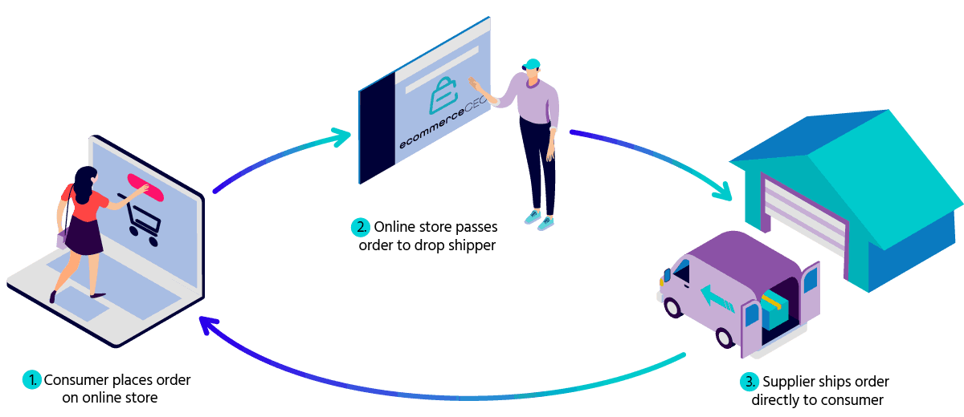

Slide 48
Click-and-mortar model:
A click-and-mortar model shop combines a website with a physical store.
Wholesaling and warehousing ecommerce businesses require a lot of investment at the start – you need to manage inventory and stock, keep track of customer orders and shipping information, and invest in the warehouse space itself.
The additional advantages are that it already has an established brand name, and that it can use its physical store to promote the website.
Further, users can return unwanted or detective items simply by going to the physical store rather than mailing it to a website operator.

Slide 49
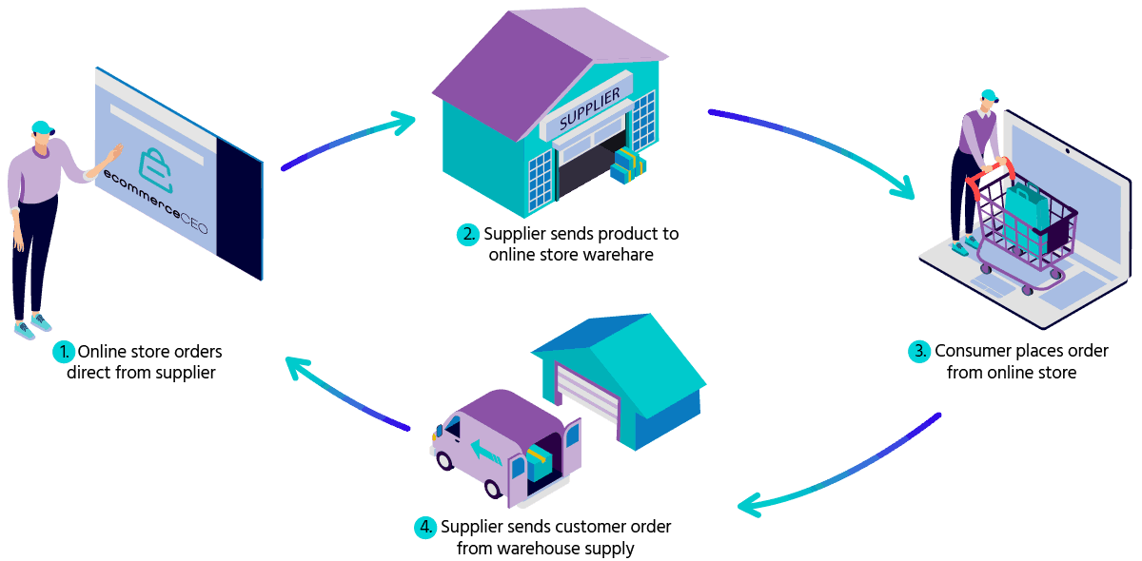

Slide 50
Built to order merchant model:
A manufacturer such as a computer vendor can use this model by offering goods or services and the ability to order customized versions.
The customized product is then assembled individually and shipped to the customer.
This model provides added value to consumers and allows the manufacturer to create only those products that will be sold.

Slide 51
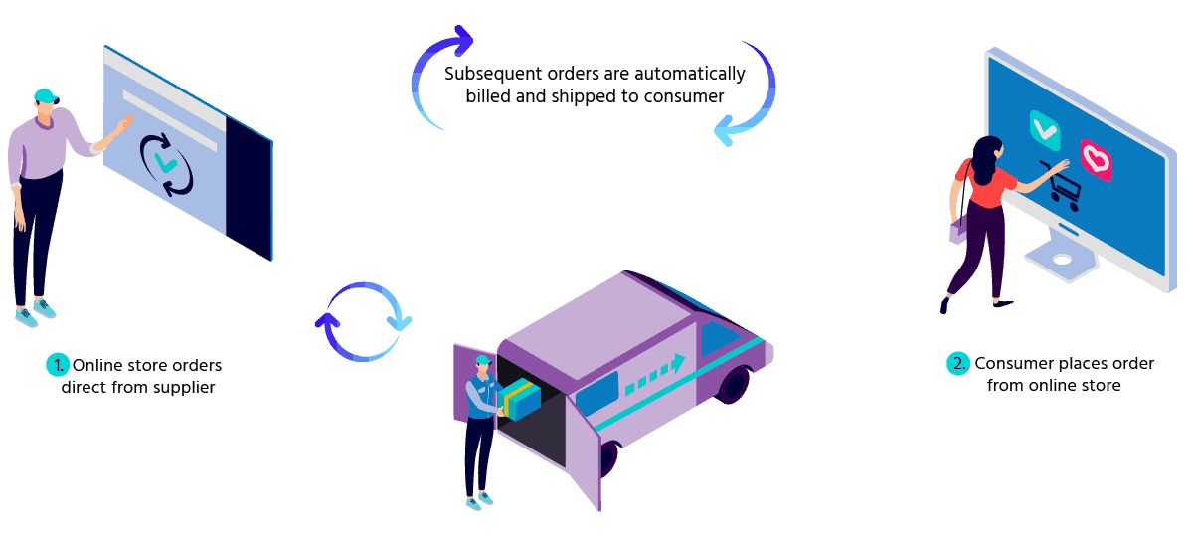

Slide 52
Subscription-based access model:
Many service operators provide subscription-based access to their service.
A visitor pays a fixed fee per month or year in return for unlimited access to the service. Access beyond a certain limit is subject to a surcharge.
This model is typical for accessing databases with articles, news, and patterns as well as online games or adult website.
However, the viability of this model is doubtful. This model is slowly gaining acceptance, because many Internet users are reluctant to pay to view content on the web.

Slide 53
Broker model:
Brokers are market makers.
As intermediaries, they bring buyers and sellers together and facilitate transactions between them.
Those can be business-to-consumer (B2C), business-to-business (B2B), or consumer-to-consumer (C2C) markets.
A broker makes money by charging a fee for every facilitated transaction or a percentage of the price of the transaction.

Slide 54
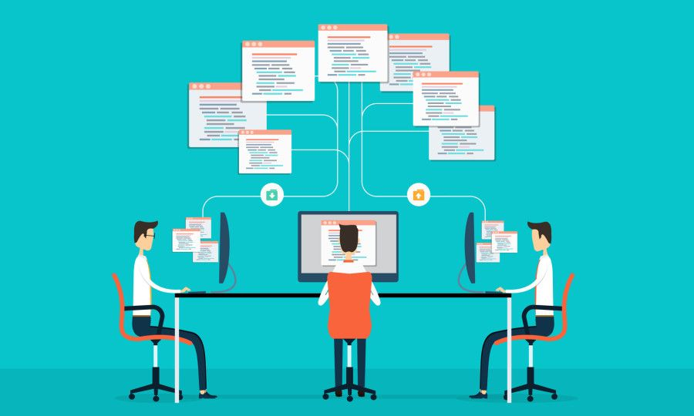

Slide 55
Free access model:
Users are given something free, but with advertisements.
A free web space provider typically provides advertising banners at the top or bottom of its sites.
Electronic greeting cards are sent with a personal message and an advertisement.
Since the visitor base is diverse, it is hard to target the right advertisements, making the revenue low.

Slide 56
Virtual community model:
It is also called a vanity site. A virtual community is a website that attracts a group of users with a common interest who work together on the site.
Users share information and make contributions in other ways.
Since they have contributed to it themselves, users feel highly loyal to the site and will visit it regularly.
A specialized type of virtual community is the knowledge network or expert site, where laymen and experts share expertise.
These sites operate like a forum. Participants get questioned answered or raise topics for discussion.

Slide 57
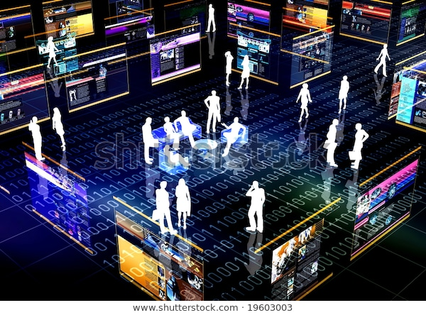

Slide 58
Infomediary model:
An infomediary collects, evaluates, and sells information on consumers and their buying behavior to other parties who want reach those consumers.
Initially, a visitor is offered something for free, like free hardware or free Internet access, which allows the infomediary to monitor the visitor’s online activities.
The information gathered can be extremely valuable for marketing purposes.
The infomediary needs to keep track of its users.
A simple way to achieve this is to require registration for access to the site, preferably for free.

